Slide 1
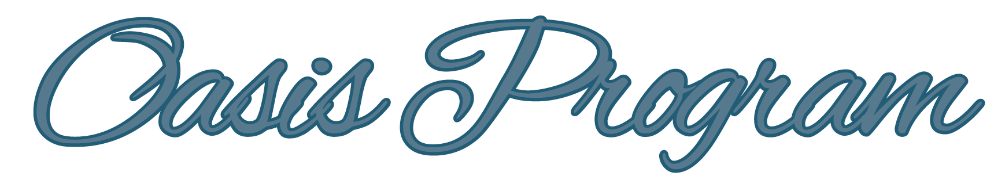
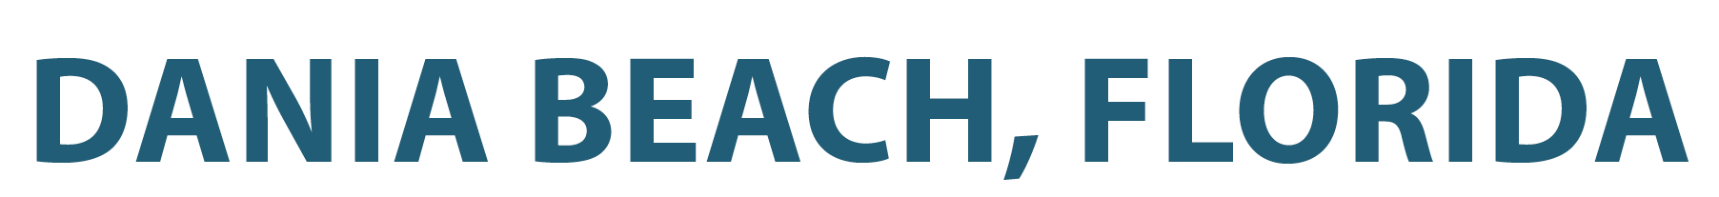
PREPARED BY : Frank Schnidman | Luis Bencosme | Natasha Vidal
JULY 2016

Slide 2
“The Dania Beach Oasis Program is a series of incremental revitalization projects focused on improving the the ‘quality of place’ of the City’s neighborhoods and thereby improving the
‘quality of life’ of its residents and visitors.”
“The Oasis Program is designed to serve the current residents and visitors of the City by improving specific streets with the goal of fostering neighborhood pride and improvement, and induce owners and tenants to stay in the City and to work together with the City to beautify Dania Beach, to increase property values, to increase personal wealth, and to reduce crime.”
Robert Baldwin
City Manager
City of Dania Beach

Slide 3
Executive
Summary
The Oasis Program
Experimental Revitalization Program
Goal to Reduce Crime and Improve Quality of Life
Cooperation Among Law Enforcement, Code Compliance, Public Services, as well as City Staff and Community Volunteers
1

Slide 4
Executive
Summary
Oasis Program Initial Report
This Report is a History of the Oasis Program
A Work in Progress That Will Be Periodically Updated to Track and Measure Performance
Companion Oasis Program Page on the City’s Web Site
2

Slide 5
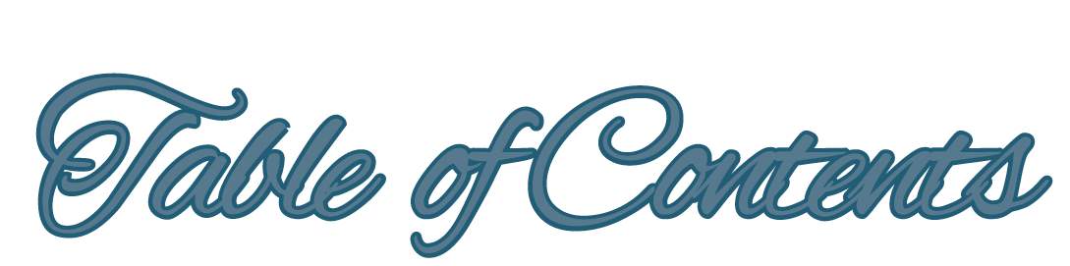
OASIS PROGRAM
Executive Summary ................................................................................................................................................................................................................................................................................................1
Table of Contents ....................................................................................................................................................................................................................................................................................................2
Oasis Project Map ...................................................................................................................................................................................................................................................................................................3
Introduction .............................................................................................................................................................................................................................................................................................................4
Project Summary .....................................................................................................................................................................................................................................................................................................6
Discussion ...............................................................................................................................................................................................................................................................................................................8
Recommendations .................................................................................................................................................................................................................................................................................................10
Acknowledgements ...............................................................................................................................................................................................................................................................................................14
101
3

Slide 6

4

Slide 7

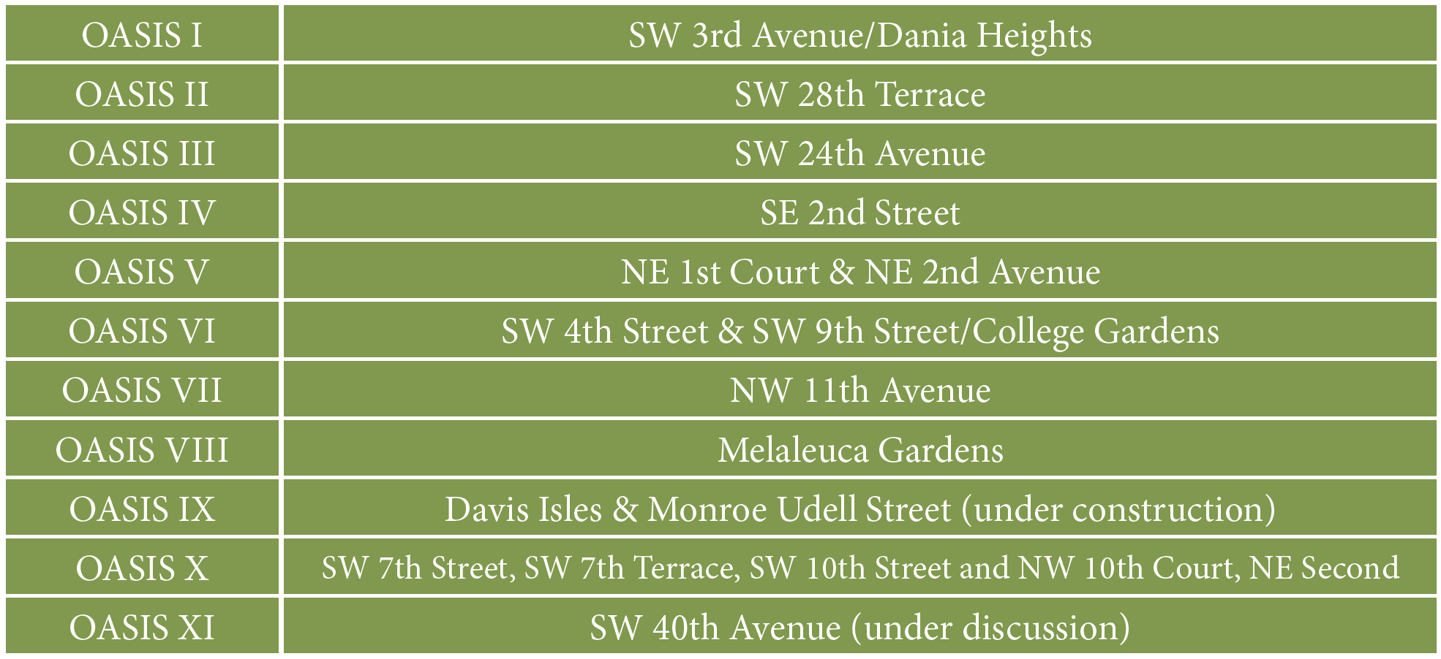
Project Location
5

Slide 8
Introduction
“Broken Windows” Approach to Crime Prevention
This approach follows the theory that by preventing small crimes it creates an atmosphere of order and lawfulness that prevents more serious crimes from happening
In effect, you address problems when they are small—repair broken windows within a short time and the tendency is that vandals are much less likely to break more windows in the future
Clean up the sidewalks and neighborhoods on a regular basis and they will stay that way
Create a sense of civic pride and the residents will respect and improve their neighborhood
Oasis I-SW 3rd Avenue from Dixie Highway to Sheridan Street
6

Slide 9
Introduction
Basic Goals of Individual Oasis Projects
Improvements to private property through volunteerism and limited funding opportunities
Increased voluntary code compliance and Building Department review
Improvements to public landscaping, street lighting, and streetscaping
Signage and boundary setting
Possible changes in vehicular and pedestrian traffic patterns
Increased citizen involvement and cooperation
Increased law enforcement attention, as necessary
7

Slide 10
As the number of individual Oasis projects were planned and implemented, a formal program evolved, with 10 Oasis projects now completed or underway and an 11th in the initial discussion phase.
It is now truly an “Oasis Program”, and time to memorialize the history and suggest methodologies and templates to track the data from each project so that when adequate data is available, the experience gained can be analyzed and recommendations for the future proposed.
Introduction
8

Slide 11
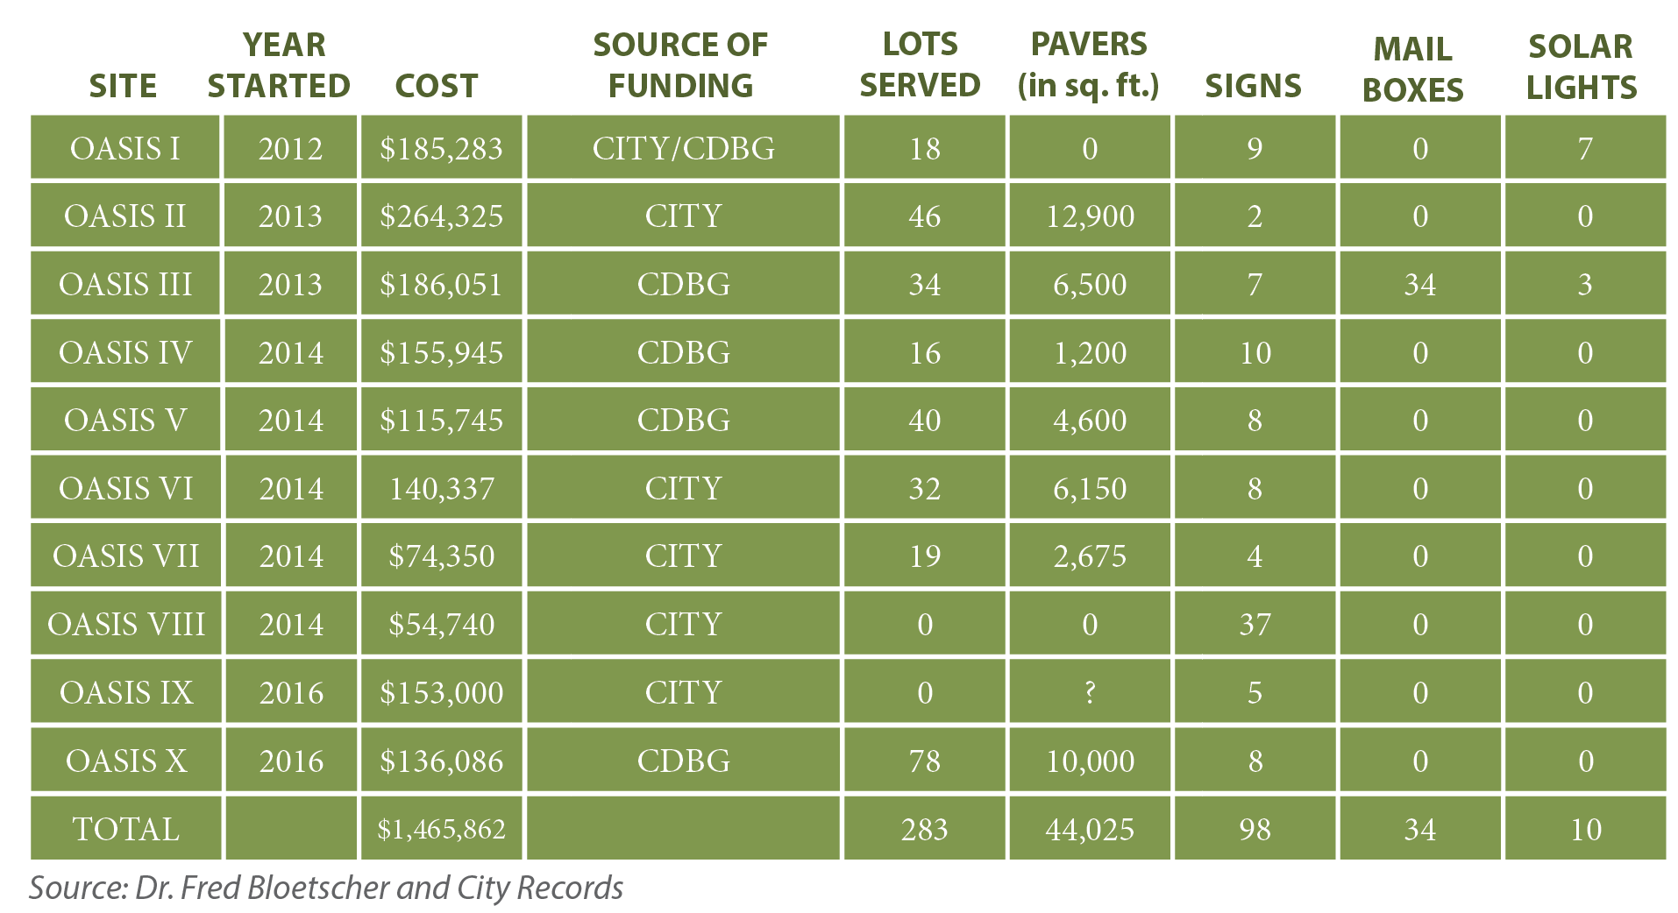
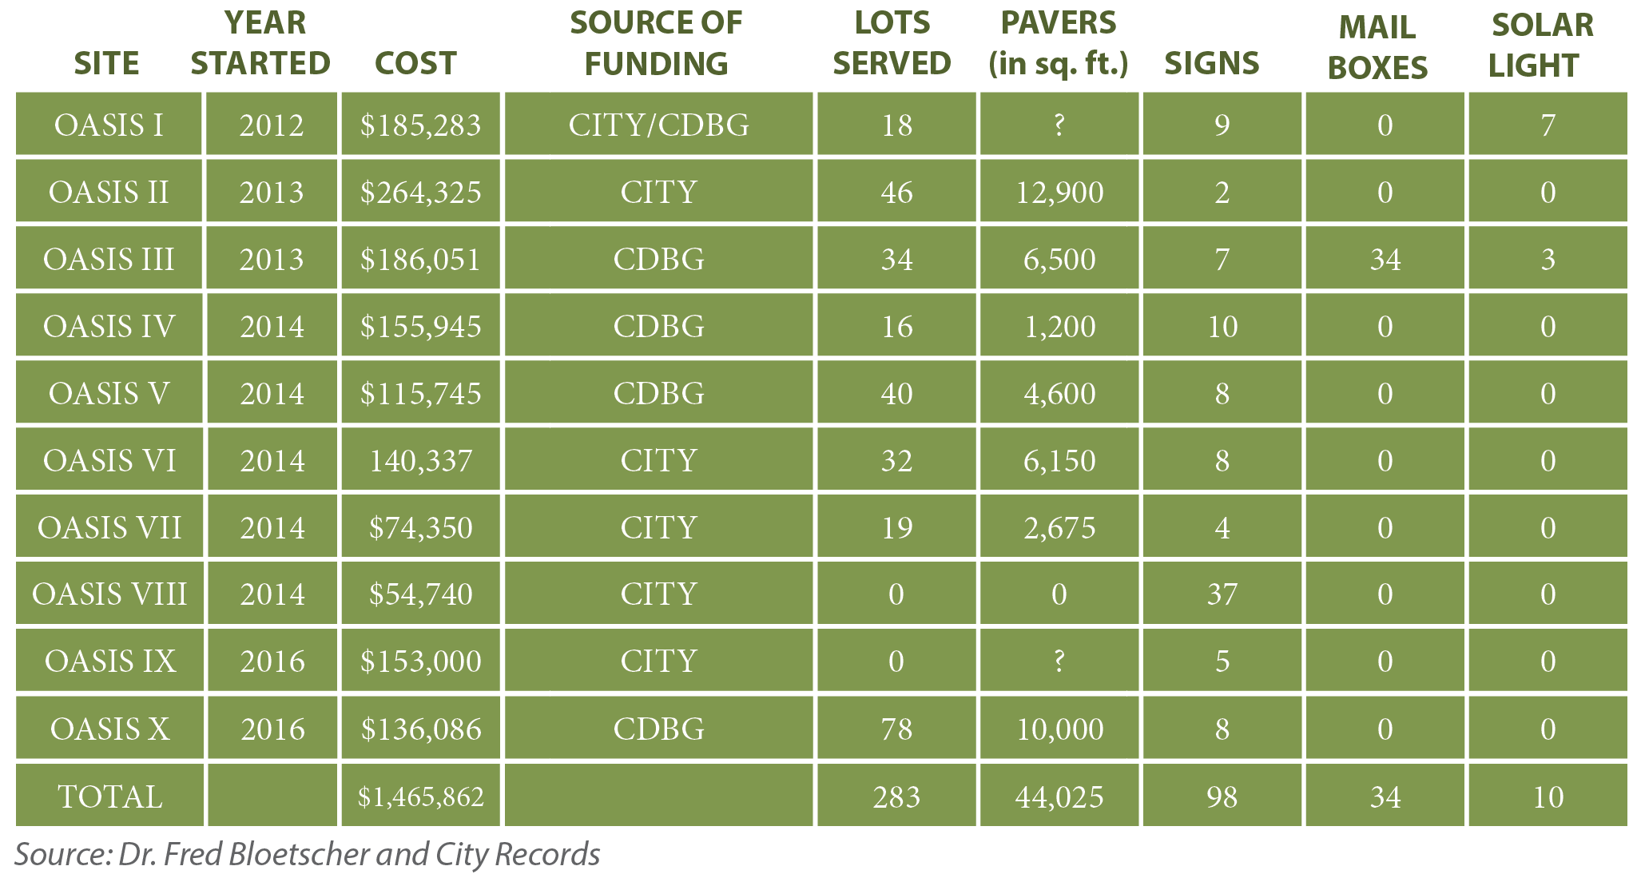
The Oasis Program projects range from a cost of $54,740 for signage in Oasis VIII to $264,325 for improvements to 46 lots in Oasis II (see Table 1). Based on available data for the Oasis projects, the average cost per Oasis project to date is approximately $146,586.
In total, over 44,000 pavers have been used for neighborhood improvements, coupled with Oasis project signage to formally designate these areas as Oasis project sites. A majority of the expense for all Oasis projects is for the cost of pavers and signage.
Project
Summary
9

Slide 12
The Oasis Program is:
Incremental Revitalization
Creation of Quality of Place
Fostering Civic Pride
Creating a Great Place to Live
Discussion
10

Slide 13
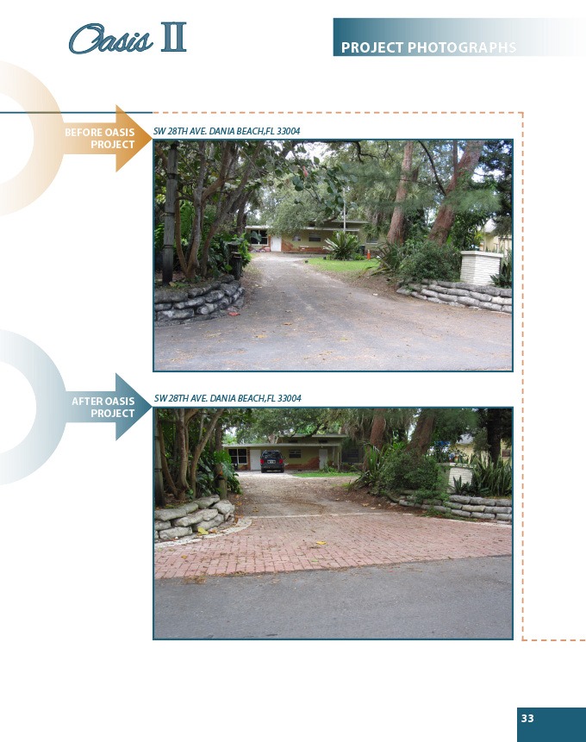
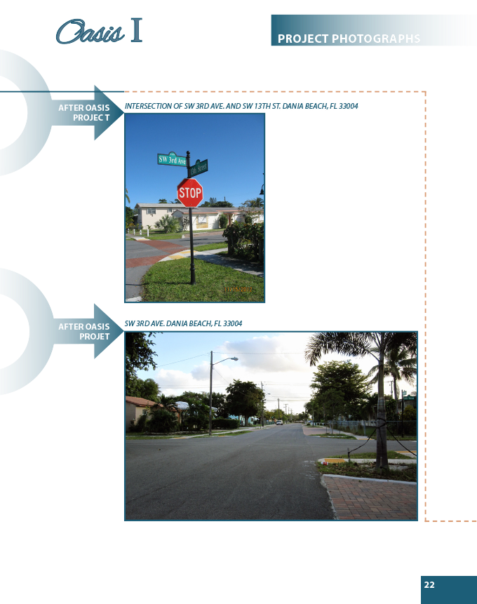
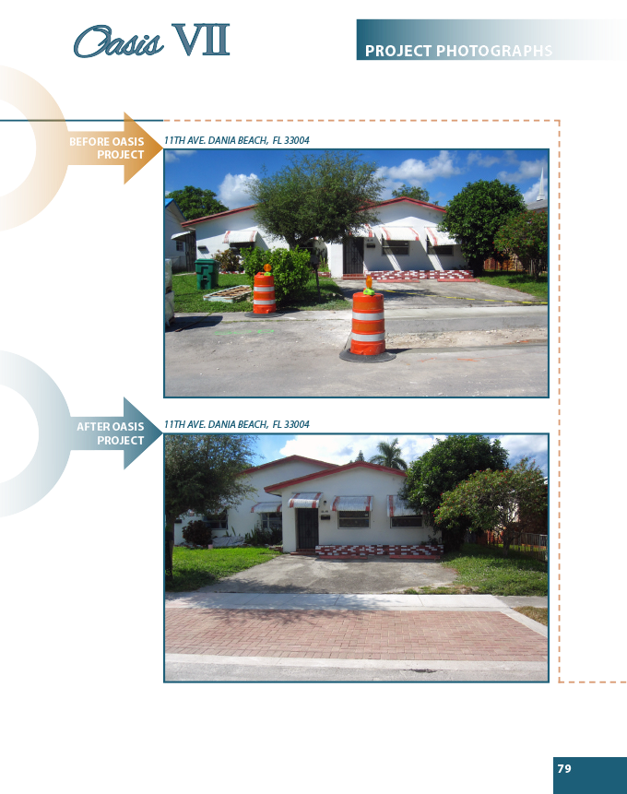
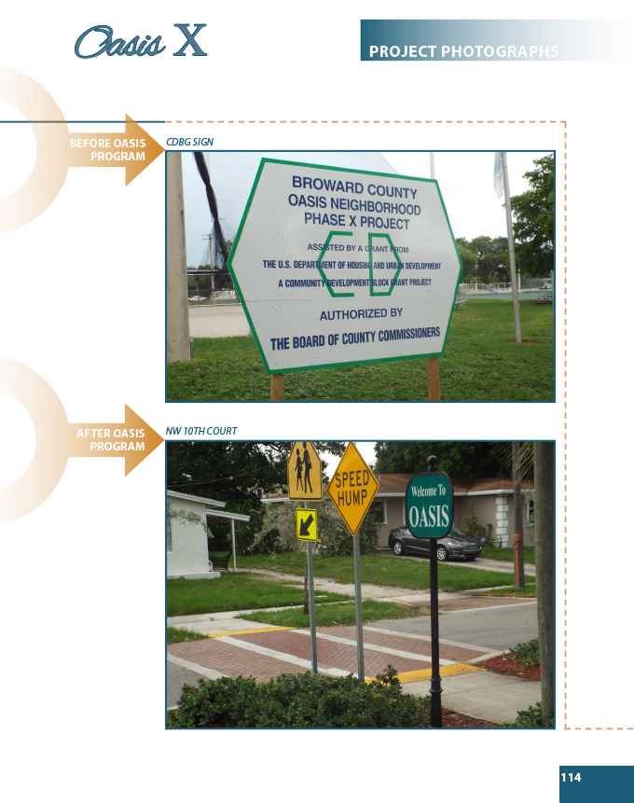
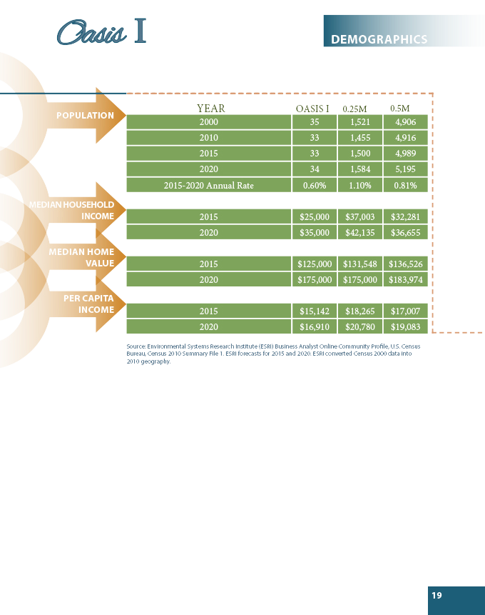
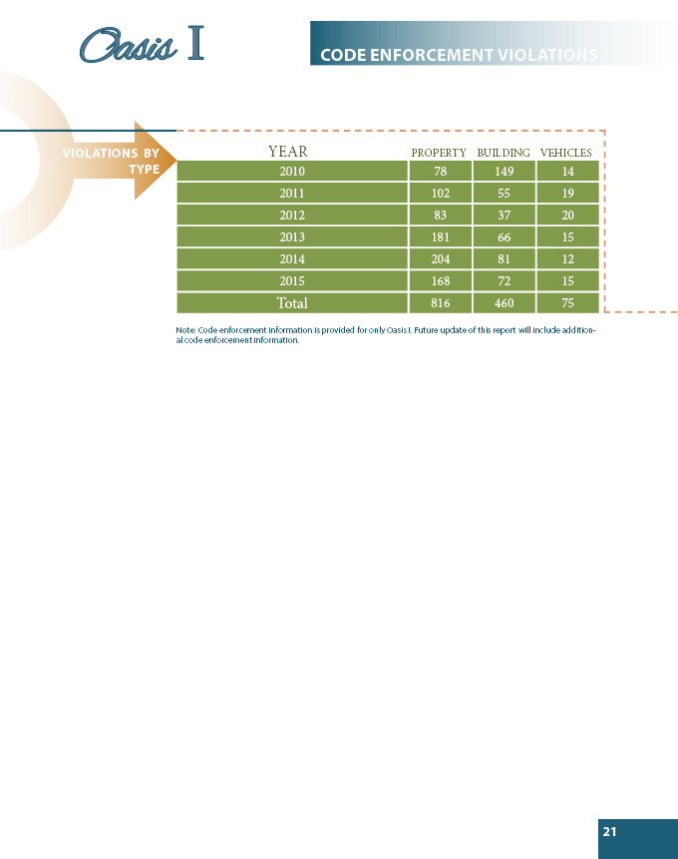
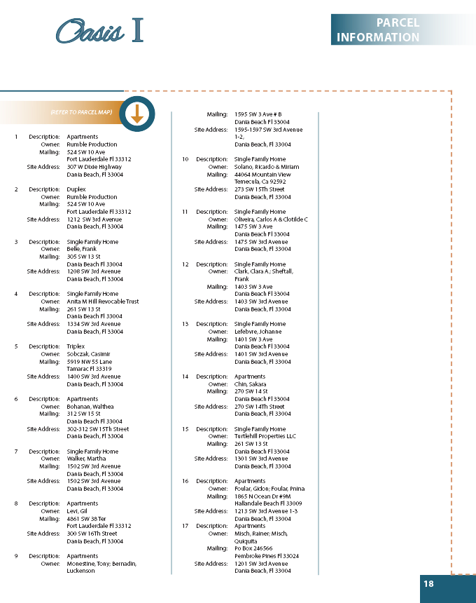
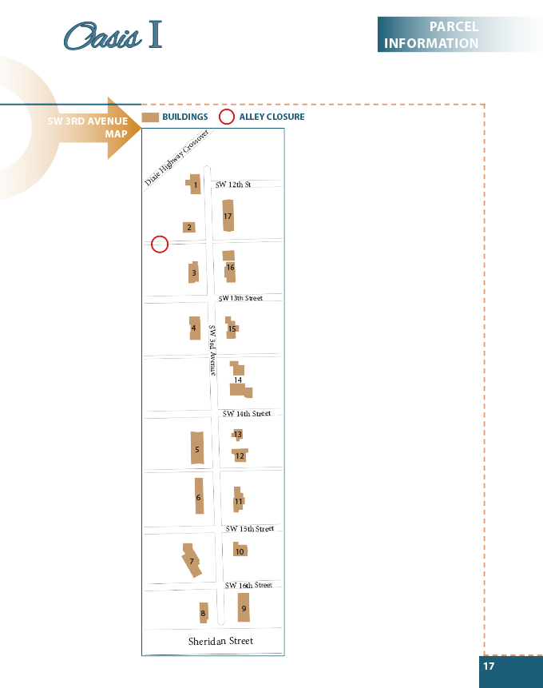
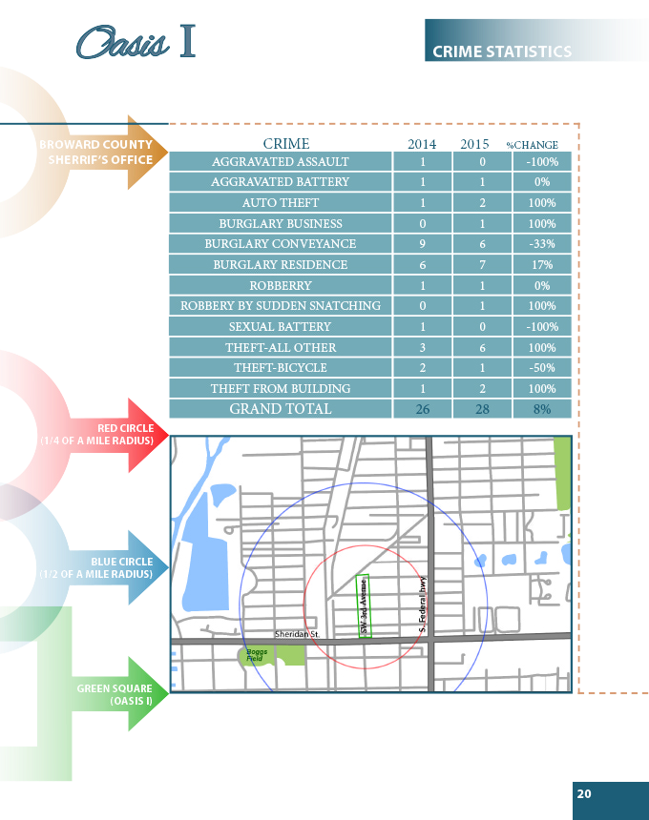
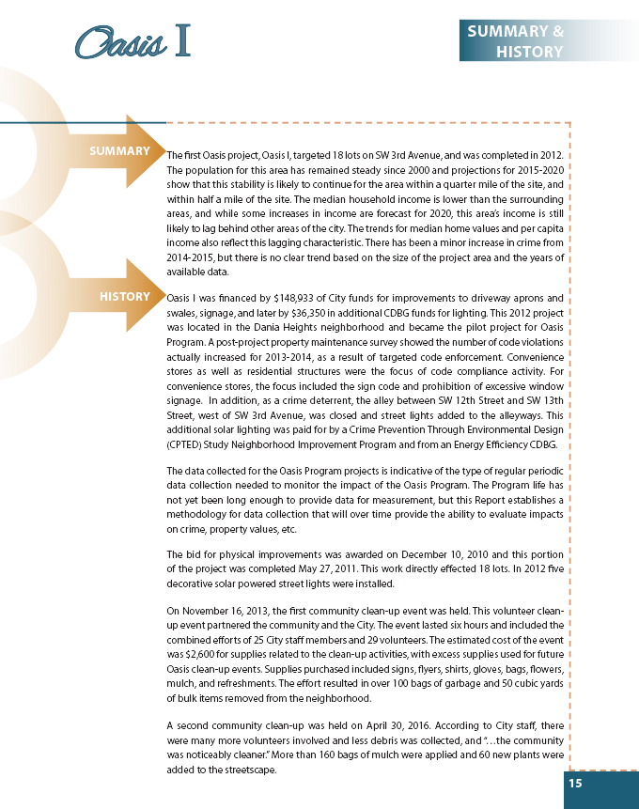
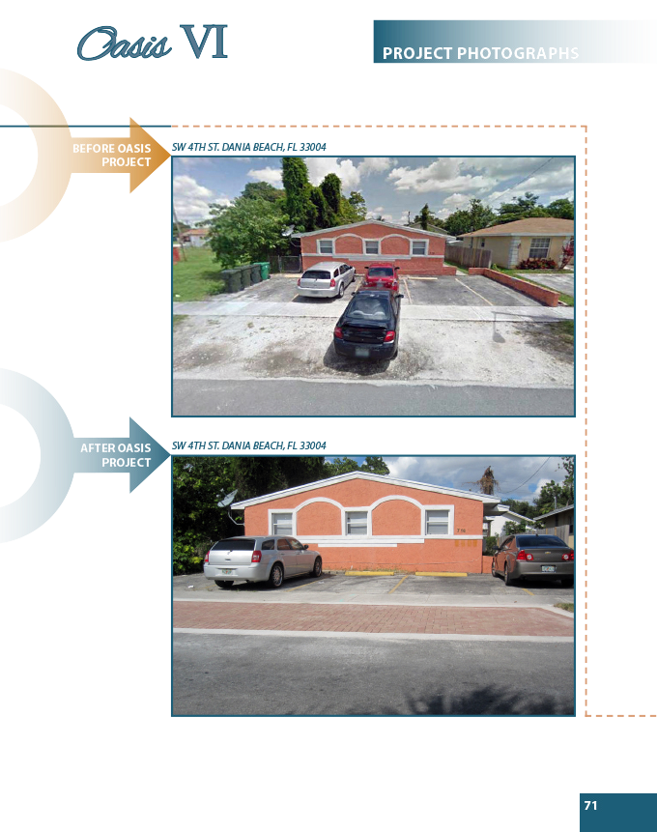
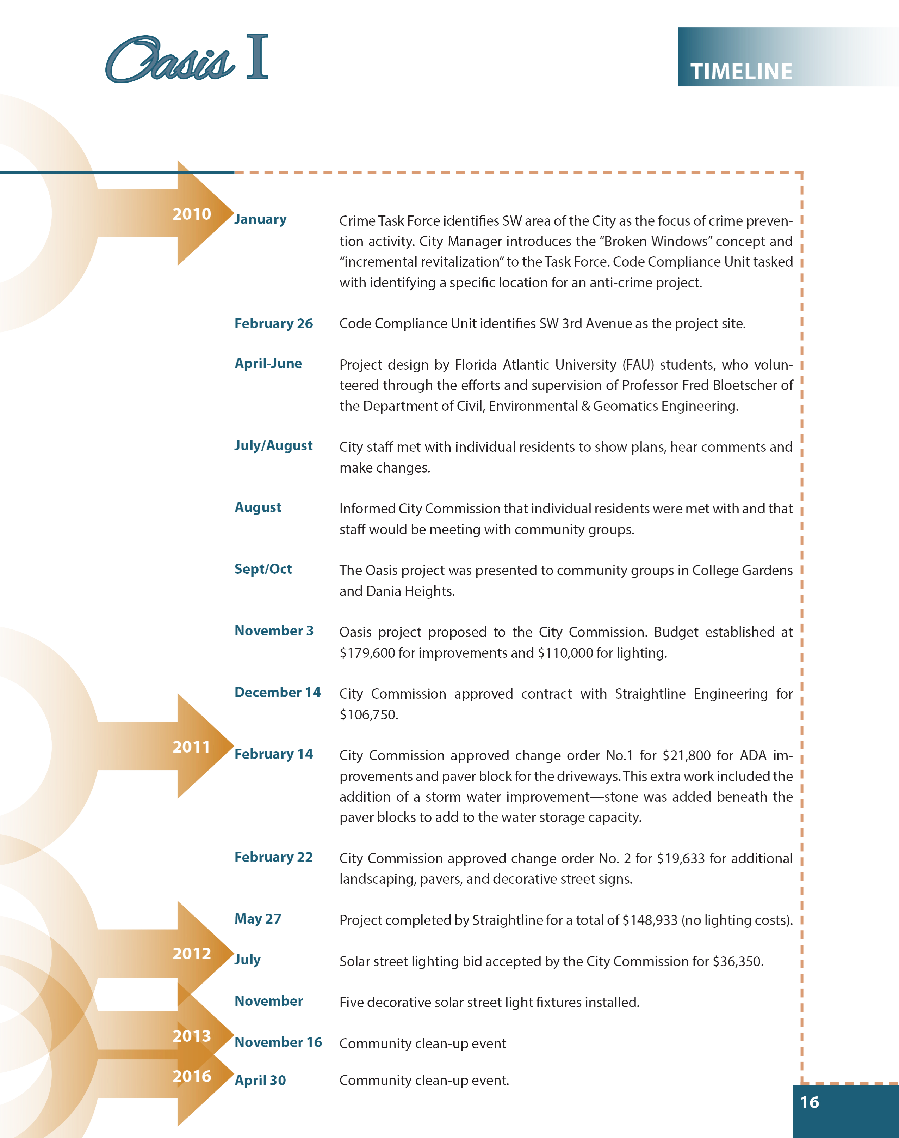
11

Slide 14
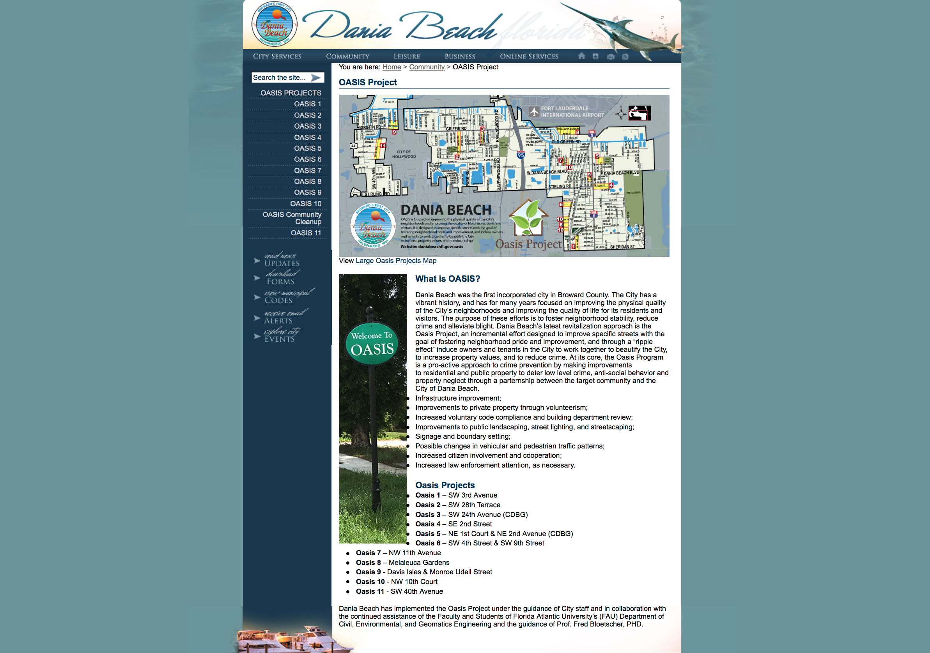
12

Slide 15
Summary
The City of Dania Beach Oasis Program is a four-year-old unique, small-scale urban revitalization effort that has successfully targeted specific streets in the City to undertake tactical urban interventions to improve the public space with the goal of fostering neighborhood pride and neighborhood improvement, increasing property values, increasing personal wealth, and reducing crime. Each of these projects included significant before, during and after community engagement, resulting in increased community cohesion, and a mutual understanding of the need to address the small issues in order to ultimately resolve the big issues. This effort, it is hoped, will induce owners and tenants to stay in the City.
The purpose of this Initial Report is to establish a process by which the effectiveness of the Oasis Program can be measured. As has been stated, this Report will be periodically updated to track the impact of the projects through crime statistics, code compliance activity, real estate transactions and changes in the assessed value of the properties for real estate taxes.
In addition, through the provision of a companion public dissemination effort, an Oasis Project page on the City of Dania Beach website has been established to enhance the information exchange with the community through a regular updating of Oasis Program projects. Interested parties will be able to check the web page for the current status of each project and learn of calendared and planned future activities.
13

Slide 16
Recommendations
Formalize the Oasis Program
Formalize the Partnership with Broward County
Seek Grant Support from the Broward Sheriff’s Office Law Enforcement
Trust Fund
Seek Grant Support from the State and Federal Government
Seek Grant Support from Private Foundations and Corporate Sponsorship
14

Slide 17
Broward County Vision
“A Sustainable Creative Approach to Community Redevelopment and Housing”
Oasis Program Could Serve as a Model for Other Broward County Communities
Revision of the Broward County Comprehensive Plan for “Targeted Redevelopment”—“Teamwork Makes the Dream Work”
15

Slide 18
City of Dania Beach
“The purpose of the Housing Element for the City of Dania Beach is to provide guidance to the City in developing appropriate plans and policies which will demonstrate its commitment to meet, identify, and project deficits in the supply of housing for all the City’s residents…This would include both the plans and policies of the government, including the City, as well as any direction or assistance which could be provided for the private sector.”
“The goal of the housing element of the City of Dania Beach is to ensure that an adequate and affordable amount of housing is provided to existing residents and the anticipated population through a coordinated effort of private sector and governmental involvement. Housing will be available to a full range of residents and will contain a variety of types and will continue the City’s policy of moving more residents toward home ownership.”
16

Slide 19
This Initial Report is a fluid document, and will be periodically updated as data becomes available to better analyze the impact of the Oasis projects. The structure of such analysis has been presented here, and the effectiveness and efficiency of various data collection techniques will be continually studied and tweaked.
17

Slide 20

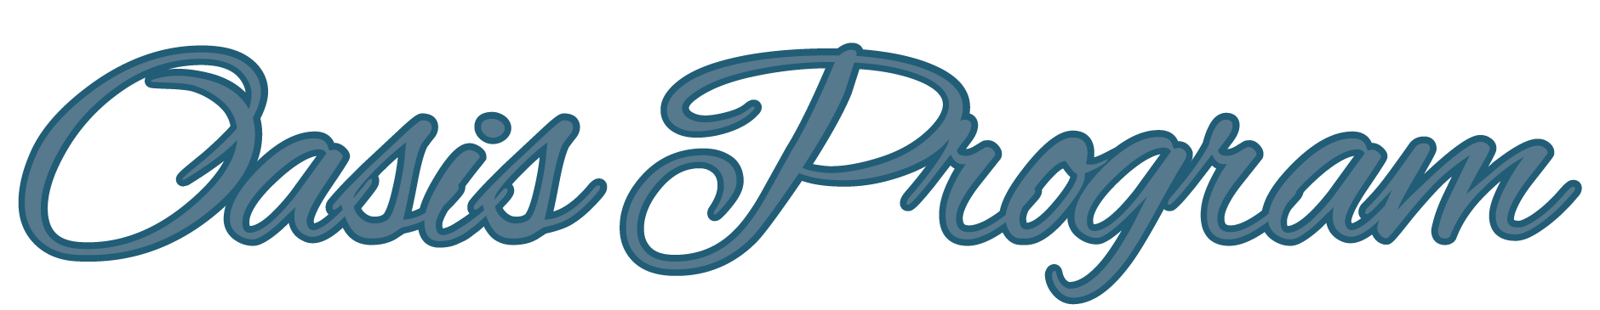
Conclusion
Dania Beach is a community with many families that have been longtime residents. The small scale incremental nature of this revitalization effort is about enhancing the quality of the environment for current residents, and not about fostering gentrification to provide for people who do not yet live in the community.
What began as a “broken windows” experiment to invest in the neighborhoods to address one of the underlying causes of crime has expanded to a community engagement effort that is enhancing the quality of place in the Oasis project areas and generated pride in the neighborhoods.
Though only 4 years old, the Oasis Program has shown that the City cares about the quality of life for its residents and wants to provide a good reason to stay in the City. The residents clearly see that something positive is happening!
18

